Slide 1
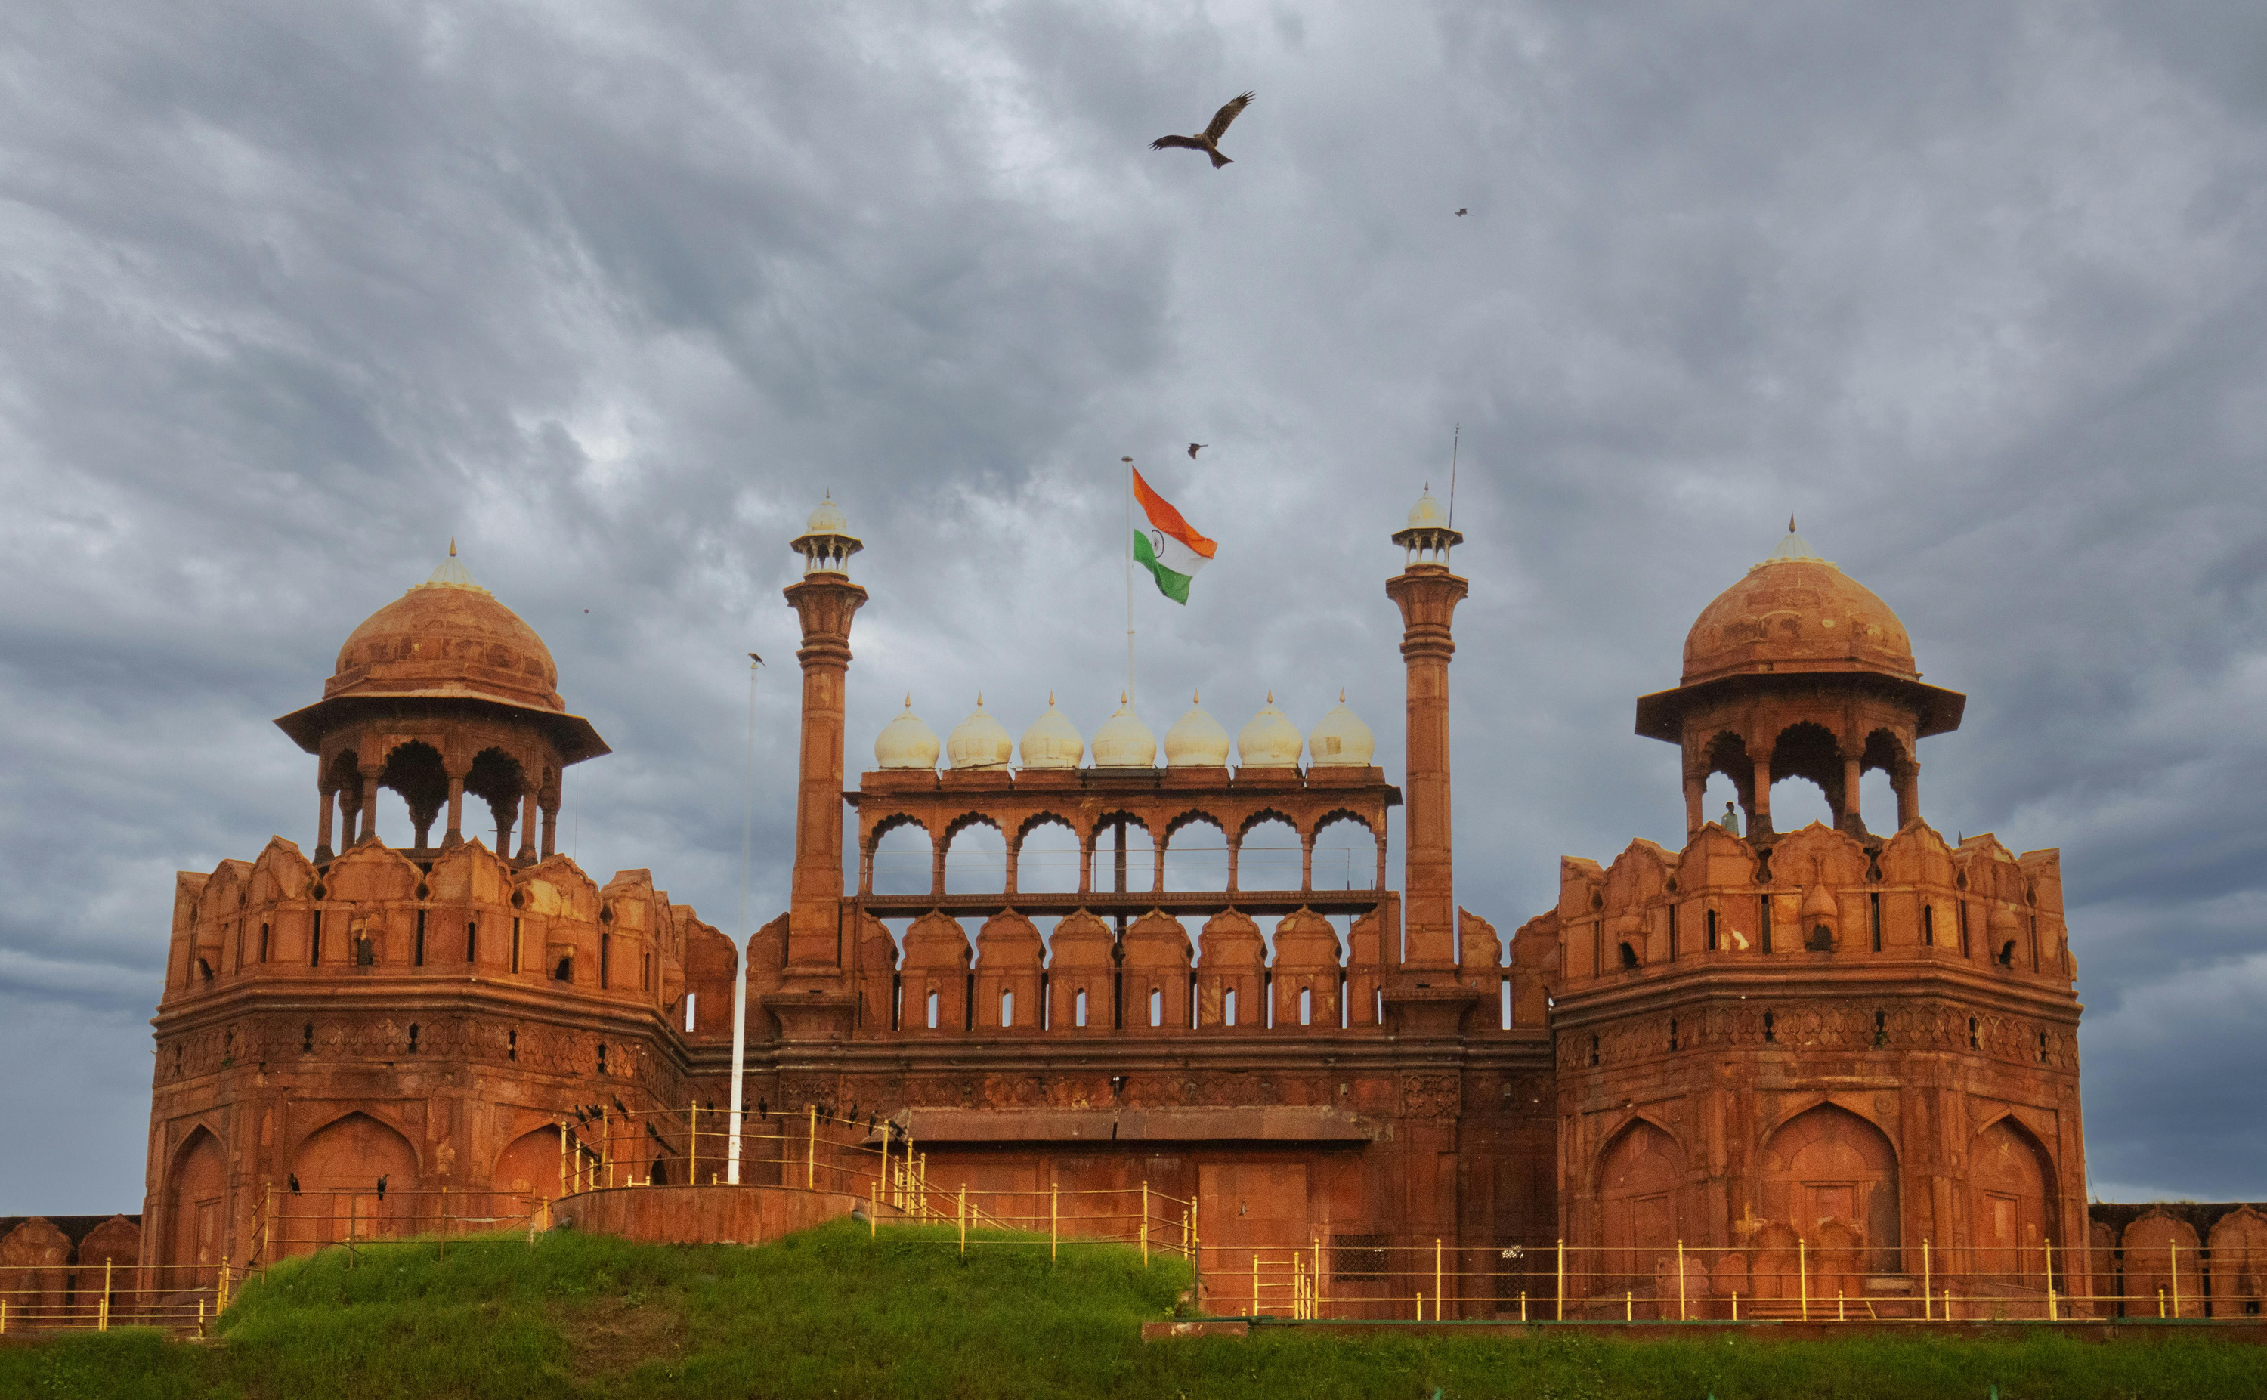




Transparent Civic Issue Management Platform
Team Name- BYTE BUSTER
Domain- AI NATIVE MARKETING OPERATIONS PLATFROM

Slide 2
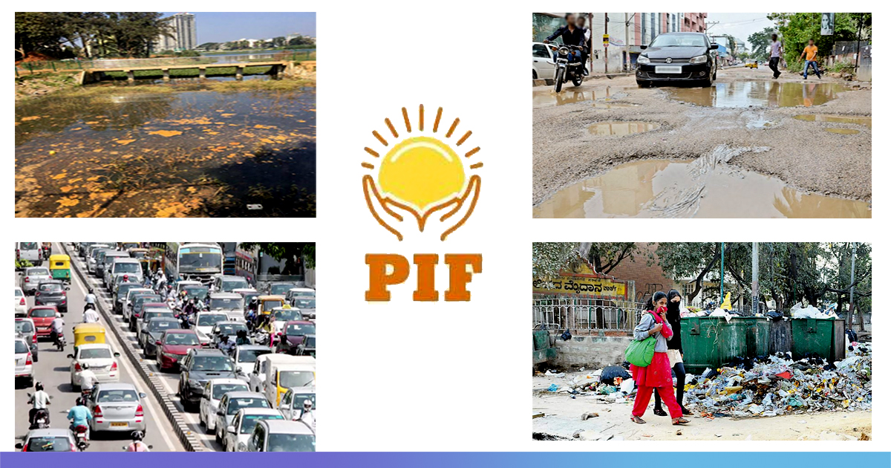
Transparent Civic Issue Management Platform
One platform for reporting, funding, tracking & verifying civic issues
Built for Indian government hierarchy
₹ INR–based, auditable, citizen-driven accountability , anti-corruption

Slide 3
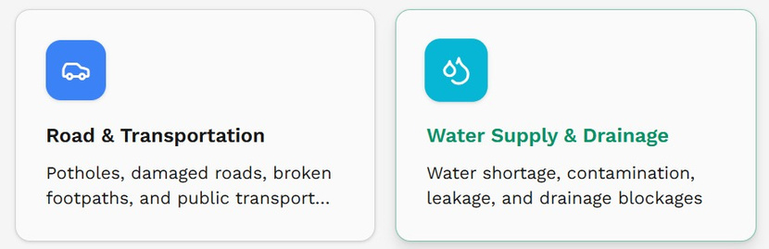
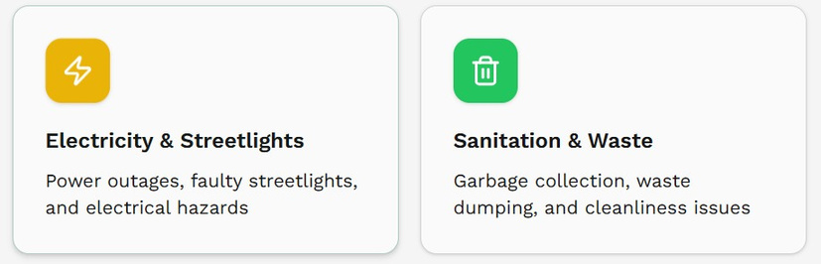
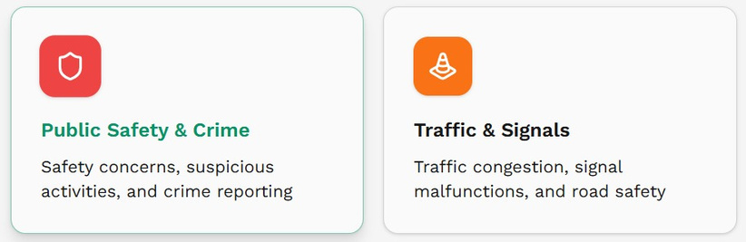
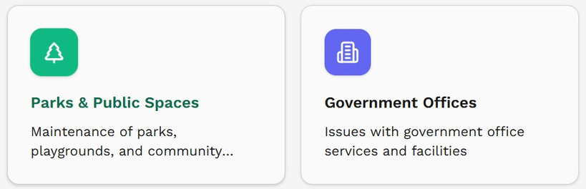
What problem are we solving?
01
02
03
Civic issues today are:
Citizens don’t know:
Who suffers?
Opaque
Slow
Unaccountable
Who is responsible
How much money is approved
Whether work is actually done
Citizens (ignored complaints)
Honest officials (no visibility)
Governments (loss of public trust)
No single trusted platform with end-to-end transparency

Slide 4
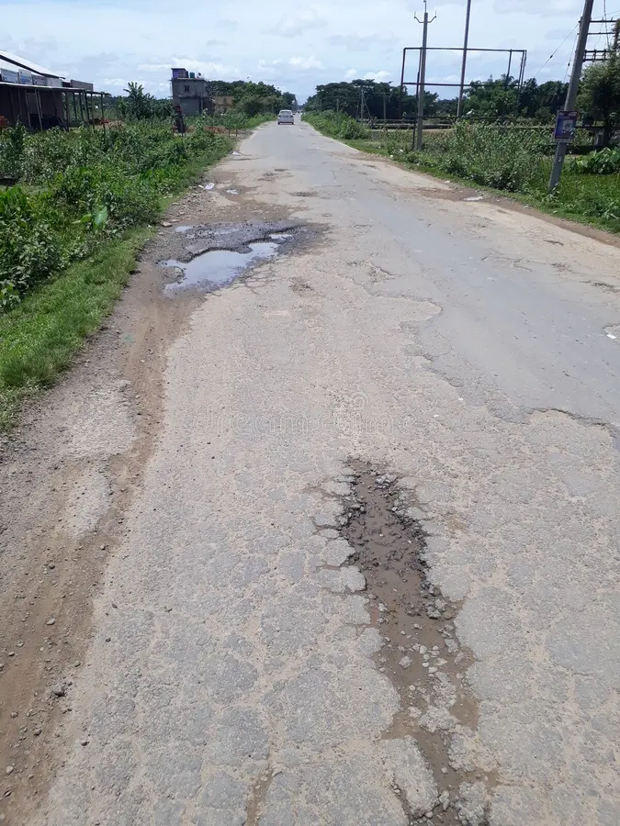
What makes this hard?
01 Real-World Constraints
02 Technical Constraints
Must follow Indian government hierarchy
Sensitive citizen data & privacy laws
Large-scale public usage
Financial correctness (₹ INR only)
Media privacy (faces, plates)
Secure payments & escrow
Immutable audit trails
SLA enforcement

Slide 5


Key Assumptions
Citizens have smartphones & internet
Government departments can onboard digitally
UPI & digital payments are standard
Location-based jurisdiction mapping is reliable

Slide 6
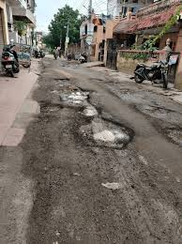

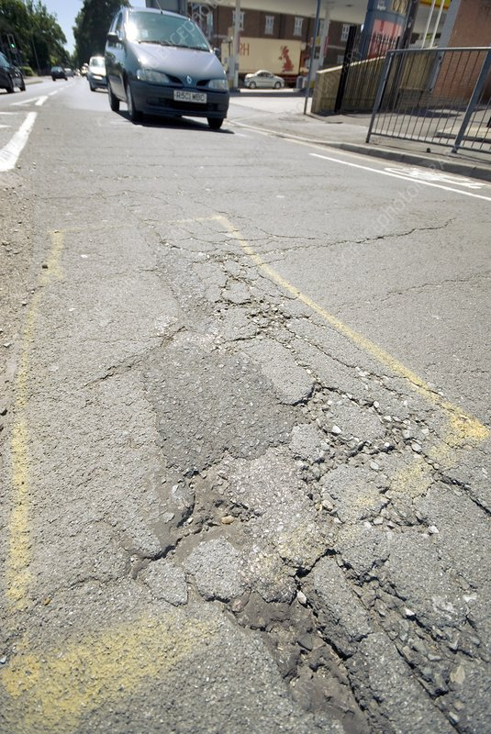
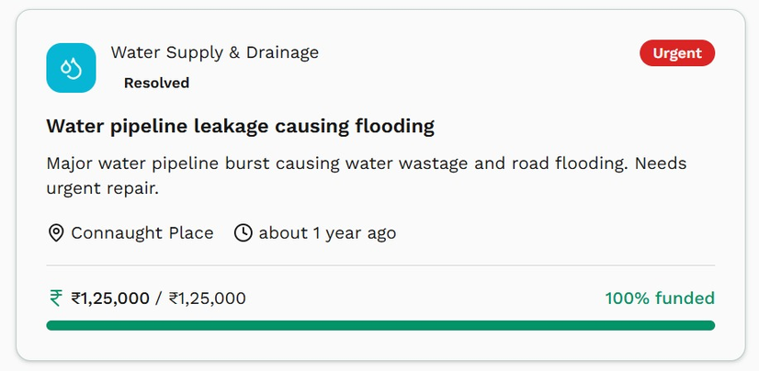
Proposed Solution
Our Core Idea :A single transparent civic platform where every issue follows a fixed, public workflow:
Why better than existing apps?
Mandatory authority routing (no manual bypass)
Public ₹ INR cost & fund visibility
Citizen + government + community in one loop
Post-resolution physical verification
Immutable audit logs
Tradeoff:
Slightly slower approvals → Much higher trust
Reported → State Reviewed → Municipal Verified → Cost Approved → Funded → In Progress → Resolved → Reviewed

Slide 7

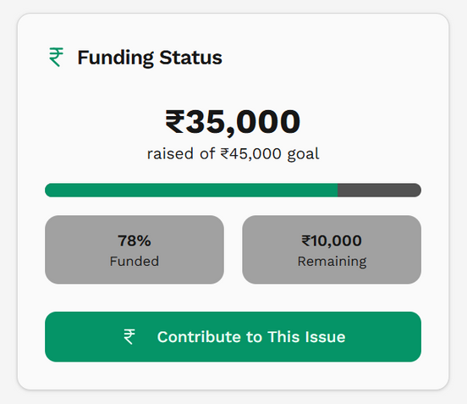
System Architecture
Components
Data Flow
Mobile App (Citizens)
Web Dashboard (Authorities & Admin)
Backend API (Workflow & Rules Engine)
AI Media Privacy Service
Payments & Wallet Service
Notification & SLA Engine
Citizen submits issue (media + location)
AI masks sensitive data
State authority review
Municipal verification
Cost & timeline approval (₹)
Funding (Govt + Community)
Execution & proof upload
Citizen review & closure

Slide 8
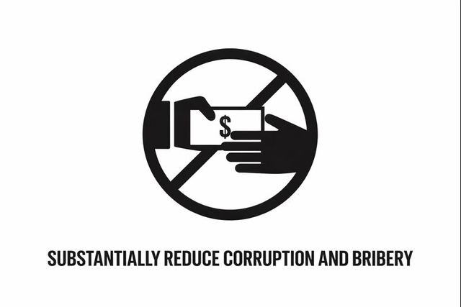

Ideal End State
If Production-Ready
Scales city → state → national level
Millions of issues with real-time tracking
Public dashboards for transparency
Data-driven governance decisions
What Breaks First
Media processing scale
Notification load
Payment concurrency
Hardening Needed
Async queues
Rate limiting
Strong audit storage

Slide 9
Hackathon Scope
✅ Citizen issue reporting
✅ Category-based workflow
✅ Authority routing logic
✅ Cost approval (₹ INR)
✅ Status lifecycle tracking
✅ Rewards (demo)
✅ SLA escalation (logic)

Slide 10




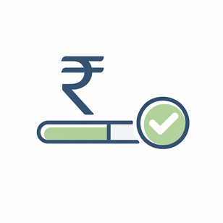


How to Run
Login as Citizen
Report an issue with image & location
State review approval
Citizen review submission
Mark resolved & submit proof
Cost approval & funding view
Municipal verification

Slide 11





AI USAGES

